Slide 1

Face Detection in a Video
Presented by
Sankrita Patel
Roll No: 22223078
MCA- VI Semester
(Session: 2024-2025)
Dr. Priyanka Tripathi
Head
Department of Computer Applications
National Institute of Technology Raipur
Dr. Naeem Ahmad
Supervisor
Department of Computer Applications
National Institute of Technology Raipur

Slide 2
Contents
Organization Details
The completion certificate from the organization
What is Face Detection?
Problem Formulation and Definition
Motivation
Contribution
Methodology
Workflow
Results and Discussion
Conclusion and Future Scope
References

Slide 3
Organization detail
Organization Name: National Informatics Centre, Raipur
Date of Joining: 01 – January – 2025
Completion Date: 20 – June – 2025
Mentor Detail:
Name: Dr. P. C. Verma
Email ID: verma.pc@gmail.com
Ph. No: 9424272972

Slide 4
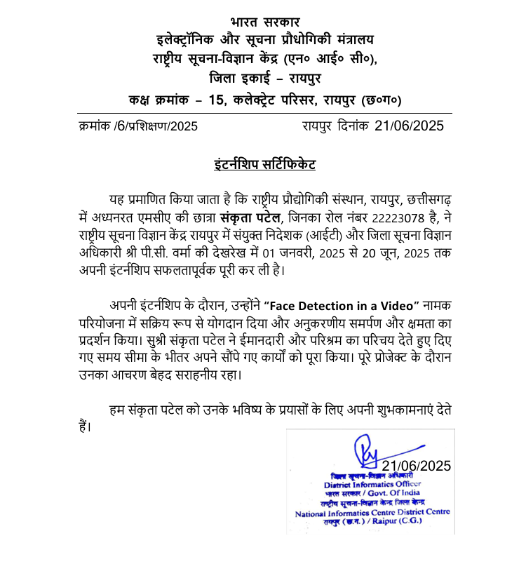
The completion certificate from the organization

Slide 5
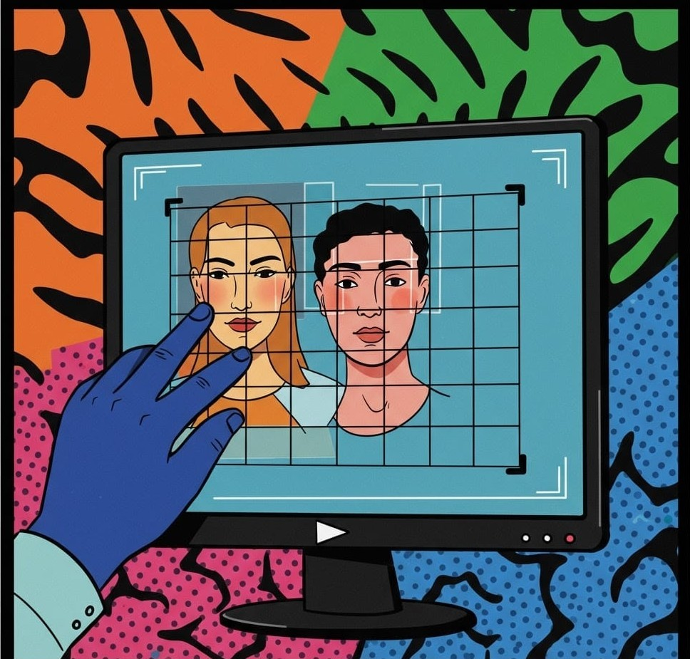
What is Face Detection?
Face Detection is a computer vision technology that automatically identifies and locates human faces in digital images or video frames. It is the first step in many facial analysis applications such as face recognition, emotion detection, and biometric authentication.

Slide 6
Problem Formulation and Definition
Face Detection is a key step in computer vision for identifying human faces in digital content.
Real – time and offline face detection has wide applications in surveillance, tagging and Interaction.
Challenges Include:
Variations in lighting, occlusions, facial expressions and movement.
Efficient video frame processing and reassembly.

Slide 7
Motivation
Increased video content across platforms demands automated face analysis.
Practical use cases include
Monitoring, privacy protection, tagging
Aim: Develop a web app that accepts videos and returns processed results with detected faces.

Slide 8
Contributions
Developed a modular face detection system using modern web and ML technologies.
Frontend in React.js, Backend in Django with OpenCV for frame-wise face detection.
Output: Processed video with bounding boxes around detected faces.
Includes:
Upload UI, Frame – by – Frame Detection and Download Interface

Slide 9
Methodology
Used Haar Cascade Classifier from OpenCV
Step – by – step Process:
Upload video from UI (React.js)
Extract Frames (OpenCV)
Apply Haar cascade classifier to detect faces
Draw rectangles on detected faces
Reconstruct video from processed frames
Return Final output to user

Slide 10
Face Detection Pipeline
Face Detection
Frontend Upload
Backend Frame Extraction
Frame Annotation
Video Compilation
Output Video Delivery

Slide 11
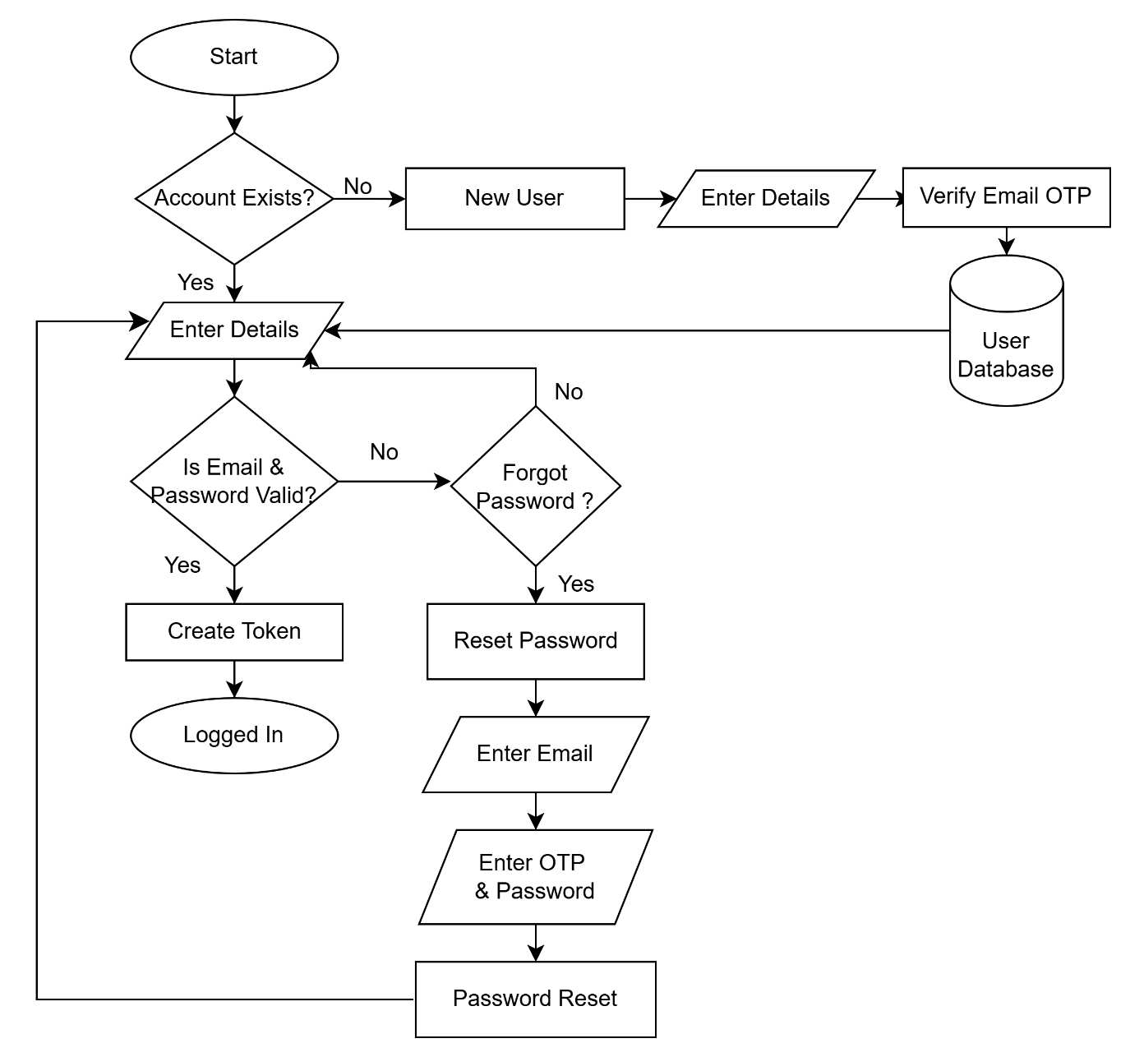
Workflow : User Authentication Flow

Slide 12
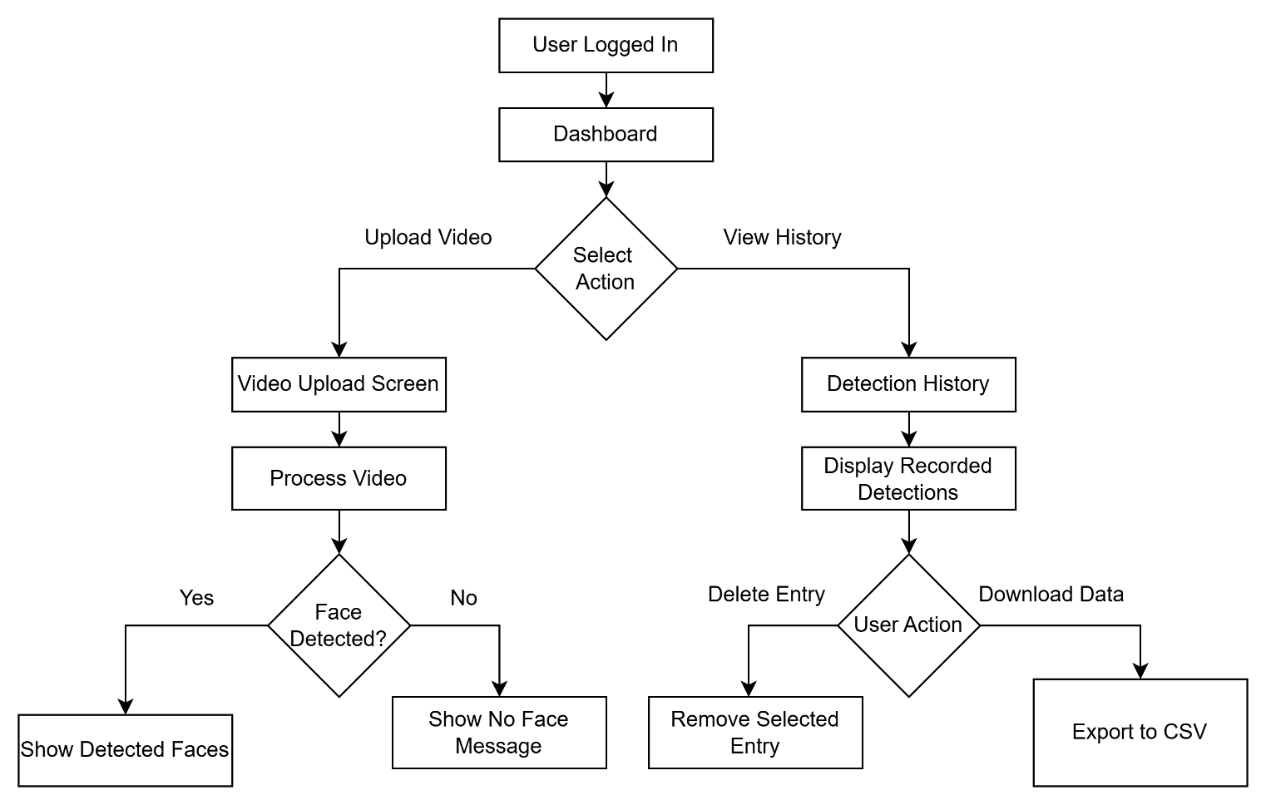
Workflow: Face Detection Flow

Slide 13
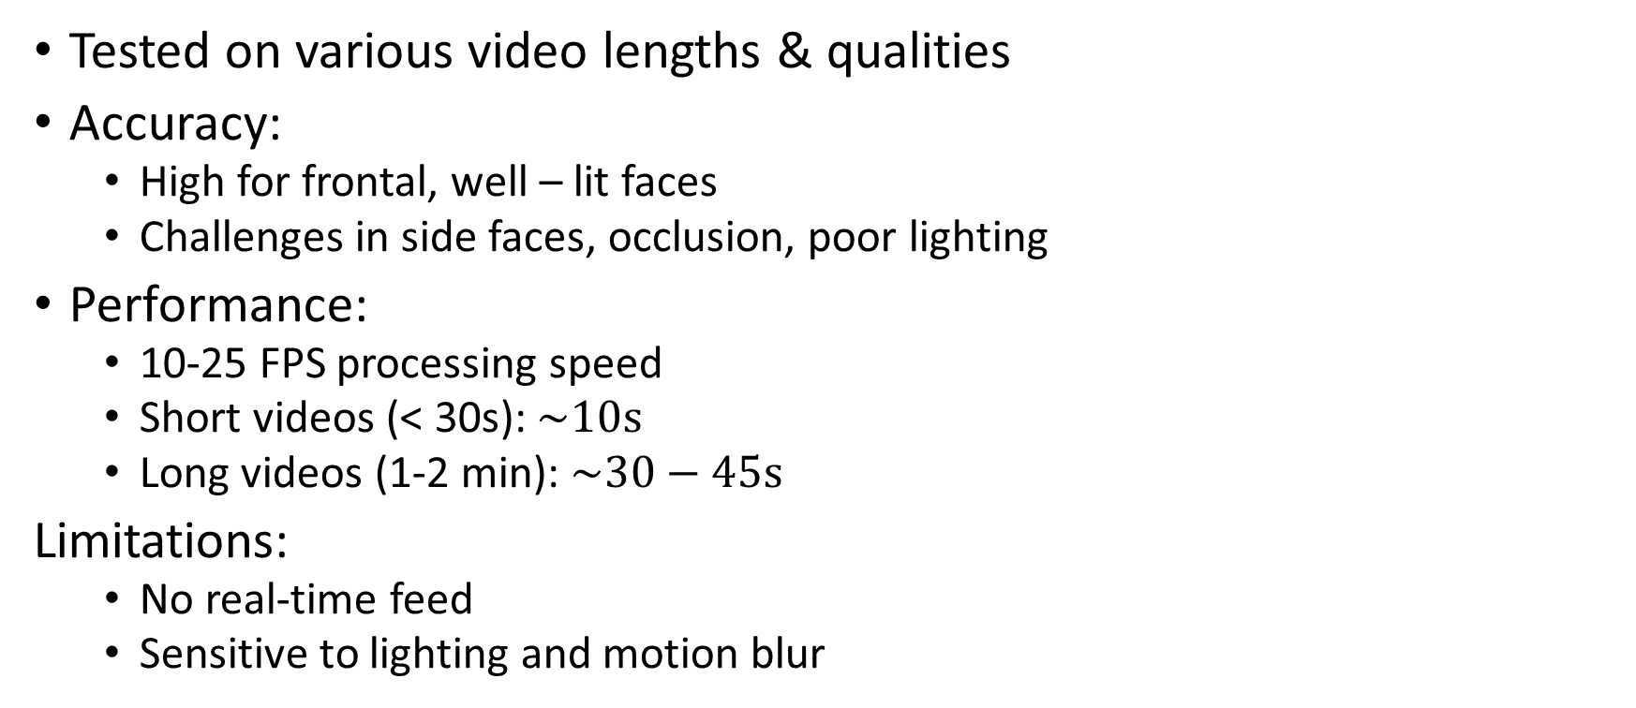
Results and Discussion
Tested on various video lengths & qualities
Accuracy:
High for frontal, well – lit faces
Challenges in side faces, occlusion, poor lighting
Performance:
10-25 FPS processing speed
Short videos (< 30s): $\sim 10s$
Long videos (1-2 min): $\sim 30−45s$
Limitations:
No real-time feed
Sensitive to lighting and motion blur

Slide 14

UI Screenshots
User Registration Page

Slide 15

UI Screenshots
Login Page

Slide 16


UI Screenshots
Forgot Password Page

Slide 17

UI Screenshots
Upload Video page

Slide 18
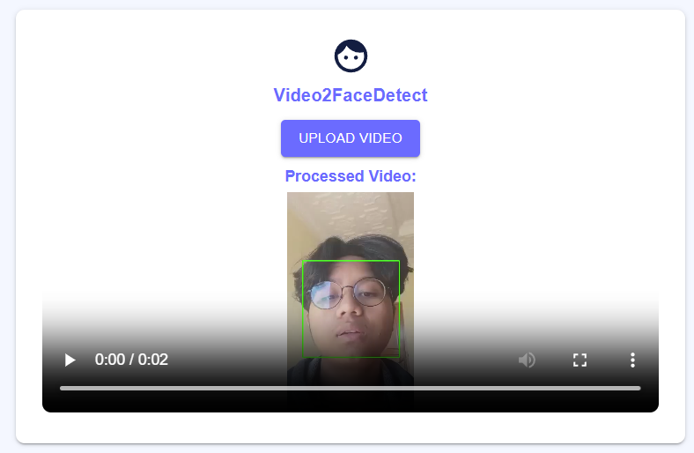
UI Screenshots
Processed Video page

Slide 19
Conclusion and Future Scope
Conclusion:
Successfully implemented a face detection system in video using traditional ML (Haar Cascade).
Integrated with a user-friendly web interface.
Future Enhancements:
Add real-time webcam feed detection
Use advanced models (YOLO, MTCNN, SSD)
UI/UX improvement with modern designs

Slide 20
References
OpenCV Haar Cascades – https://github.com/opencv/opencv
Django Documentation – https://docs.djangoproject.com
React.js – https://reactjs.org

Slide 21
Thank You!
Q & A

